Slide 1
Miscellaneous
Ehsan Yazdian

Slide 2
Random numbers
$random(<seed>);
Example:
integer seed;
initial addr = $random(seed);
The value of <seed> is optional and is used to ensure the same random number sequence each time the test is run.
The seed value should be assigned to this variable prior to calling $random.
For each $random function, the seed parameter is an inout port; that is, a value is passed to the function and a different value is returned.
Example with seed: initial begin
integer seed1=1 ,seed2=1254;
always #10 rand1=$random(seed1);
always #10 rand2=$random(seed2);
// This code generates two different random sequences. New random variables and new seeds are generated each time the function is executed.

Slide 3
Useful System Tasks
Display | File Output
$display | $fdisplay
$monitor | $fmonitor
$strobe | $fstrobe
$display (“format string”, argument list)
$monitor (“format string”, argument list)
$strobe (“format string”, argument list)
Examples:
$display("Hello Verilog World");
-- Hello Verilog World
reg [4:0] port_id;
$display("ID of the port is %b", port_id);
reg [0:40] virtual_addr;
$display("At time %d virtual address is %h", $time, virtual_addr);
-- At time 200 virtual address is 1fe0000001c
$display(“We are inside %m"); //Displaying Hierarchy
Sample Output: We are inside top.fulladd_inst
Formatters can be used:
Formatters:
%b %c %h %d %t %o %s %m
Special Charachters:
\” (double quote) \n (new line) \\(backslash) \t(tab)

Slide 4
Monitor and strobe
$monitor:
to monitor changes in the signal values in its argument list .
Only one $monitor system task can be active.
Example:
$monitor(“Values are:%d,%d.",p1,p2);
We can enable or disable monitoring with
$monitoron
$monitoroff
to restrict monitoring to intervals of time, rather than monitoring entire remainder of simulation session.
$strobe:
Similar to the $display task.
Always executed after all tasks in the same time.

Slide 5
Writing to Files
Declaring an integer that is used to represent the file and then opening the file.
$fopen is used to open a file:
“r” Open for reading
“w” Truncate to zero length or create for writing
“a” Append (open for writing at end of file)
The file is closed automatically at the end of simulation
The $fclose function can be called to close a file.
Example
integer handle1, handle2;
initial begin
handle1 = $fopen("file1.out"); // handle1 = 32'h0000_0002 (set bit 1)
handle2 = $fopen("file2.out“); // handle2 = 32'h0000_0004 (set bit 2)
$fdisplay(handle1, "Display file1.out"); //write to file1.out
... . . . .
#100 $fclose (handle1);
$fclose (handle2);
end

Slide 6
Exampel
A single $fdisplay command can write to more than one file.
The trick is to use the symbol “|” to connect the file numbers
The integer number 1 is reserved for the screen and log file.
Only 31 files can be opened at a time.
integer desc1;
integer handle1, handle2,;
Initial begin
handle1 = $fopen("file1.out"); //handle1 = 32'h0000_0002 (bit 1 set)
handle2 = $fopen("file2.out"); //handle2 = 32'h0000_0004 (bit 2 set)
end
initial begin
$fdisplay(handle1 | 1 , "Display 1");//write to file1.out & stdout
desc1 = handle2 | handle1; //desc2 = 32'h0000_0006
$fdisplay(desc2, "Display 2");//write to file1.out & file2.out
end

Slide 7
File Reading
$readmemb: Reads a file in binary and stores it in a reg variable
$readmemh :reads in hex
Input file must contain only numbers in the specified format.
start_add is the starting address of the memory where the data is began to store.
$readmemb (“file name”, reg_name, [start_add, finish_add]);
$readmemh (“file name”, reg_name, [start_add, finish_add]);
Also $fscanf can be used to read files similar to matlab, ….

Slide 8
Exmaple
reg [7:0] mem [0:1023];
initial $readmemb("memory.txt",mem);
memory.txt
//Comments are allowed
1100_1100 // This is first address i.e 8'h00
1010_1010 // This is second address i.e 8'h01
@5 // Jump to new address 5
0101_1010 // This is address 8'h55
0110_1001 // This is address 8'h56

Slide 9
Simulation Time:
$time
A time variable is declared with the keyword time.
The width for time register data types is implementation-specific but is at least 64 bits.
The system function $time is invoked to get the current simulation time.
Example:
time save_sim_time;
initial save_sim_time = $time;
$monitor($time, " In register value = %b\n", a[2:0]);

Slide 10
Force and Release
They can be used to override assignments on both registers and nets.
Typically used in the interactive debugging process.
They should appear only in stimulus or as debug statements.
Example
initial begin
#50 force dff.q = 1'b1; //force value of q to 1 at time 50.
#50 release dff.q; //release the value of q at time 100.
end
assign out = a & b & c;
initial begin
#50 force out = a | b & c;
#50 release out;
end

Slide 11
Generate Statement
Generating multiple instances of modules, primitives, variables, nets, tasks, functions, continuous assignments, initial and always procedures.
Keywords:
generate
endgenerate
genvar: a data type, which stores positive integer values.
A generate block can use for loops, if–else and case decisions.
The index variable used in a generate loop must be declared as a genvar.

Slide 12
Examples
Using generate to conditionally instance modules:
module multiplier (a, b, product);
input [a_width-1:0] a;
input [b_width-1:0] b;
output [product_width-1:0] product;
parameter a_width = 8, b_width = 8;
localparam product_width = a_width+b_width;
generate
if((a_width < 8) || (b_width < 8))
multiplier_type1 #(a_width, b_width) mult_inst (a, b, product);
else
multiplier_type2 #(a_width, b_width) mult_inst (a, b, product);
endgenerate
endmodule

Slide 13
Examples
Generate Loop: Convert Gray code into binary code
Dataflow Modeling
parameter SIZE = 8;
input [SIZE-1:0] gray;
output [SIZE-1:0] bin;
genvar i;
generate
for (i = 0; i < SIZE; i = i + 1) begin: bit
assign bin[i] = ^gray[SIZE-1:i];
end
endgenerate
Using Behavioural Modeling
generate
for (i = 0; i < SIZE; i = i + 1) begin:bit
always @(*)
bin[i] = ^gray[SIZE - 1: i];
end
endgenerate
Important Note: Generated begin-end blocks must be named

Slide 14
Examples
Building An Adder:
module adder_nbit #(parameter N=4)(x, y, c_in, sum, c_out);
…
genvar i;
wire [N-2:0] c; // internal carries declared as nets.
generate
for (i = 0; i < N; i = i + 1) begin: adder
if (i == 0) // specify LSB
full_adder fa (x[i], y[i], c_in, sum[i], c[i]);
else if (i == N-1) // specify MSB
full_adder fa (x[i], y[i], c[i-1], sum[i], c_out);
else // specify other bits
full_adder fa (x[i], y[i], c[i-1], sum[i], c[i]);
end
endgenerate
In this case the name of instances are adder[0].fa, adder[1].fa, adder[2].fa, adder[3].fa.

Slide 15
Define Command
syntax: `define
used to define text macros in Verilog
Verilog compiler substitutes the text of the macro wherever it encounters a `<macro_name>.
`define S $stop;
//define a frequently used text string
`define WORD_REG reg [31:0]
// you can then define a 32-bit register as `WORD_REG reg32;
`define TRUE 1'b1;
reg continue = `TRUE;

Slide 16
Compiler Directives
`ifdef, `ifndef, `else, `elsif, `endif
Conditionally compiles Verilog code, depending on whether or not a specified macro is defined.
Can be used anywhere in the code.
module testifdef;
reg clk=0;
`define 10MHz
`ifdef 20MHz
always #25 clk = ~clk;
`elsif 10MHz
always #50 clk = ~clk;
`else
always #5 clk = ~clk;
`endif
endmodule

Slide 17
Compiler Directives
`include
Insert the entire contents of a source file into another file during Verilog compilation.
Example
`include "definitions.v“

Slide 18
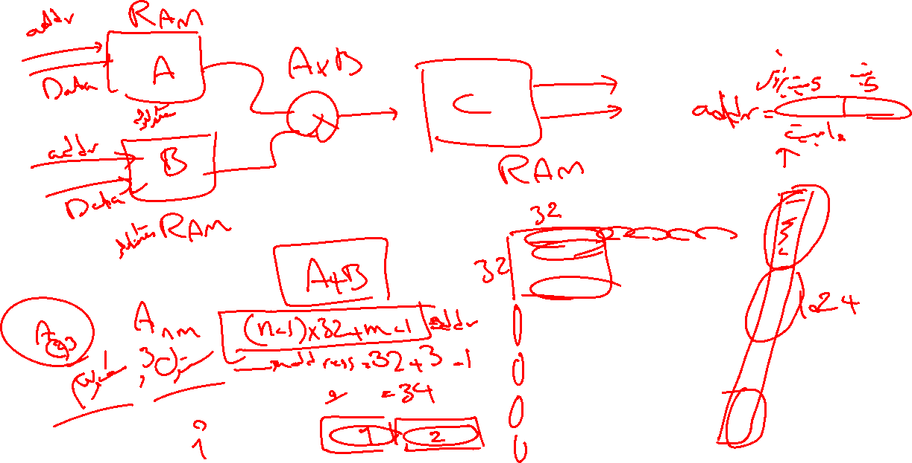
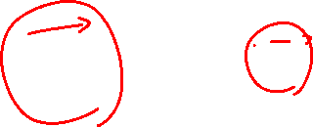
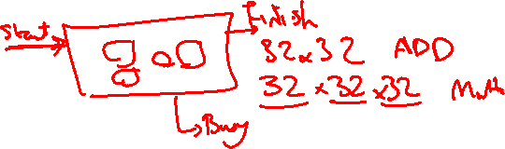

Slide 19
